Slide 1
AT&T Online & Care Trend Analytics

Slide 2
AT&T Customer & Agent Trend Analysis
Key facts about topic
As part of this Project want to view online customers Trends of AT&T Customers , Agent treads. Also wants to see correlation between these trends.
Major hypothesis considered are :
* Online Login failures impacts Agent activity frequency.
* Online Profile Update failures impacts Agent activity frequency.
* Online Payment failures impacts Agent activity frequency.
* Login Failures online driving customers to unauth payment flow.
* Payment Failures online driving customers to unauth payment flow.
* More Login volumes on a day indicates more Change Plan/Feature Activities.
* More Login Volumes on a day indicates increased number of customer activity failures.
* Customer online activity failures are related to customer complains on Feedback forums.
* Tokenization of customer feedback and prioritizing of issues.
Notes:
QuickStarter has created an outline to help you get started on your presentation. Some slides include information here in the notes to provide additional topics for you to research.

Slide 3

Contents
Agenda
Source of Data
Cleaning of Data
ETL Activities
Technical Fronts
Rest Endpoints
Visualization
ML Models
Building a Frontend View
Challenges
Limitations

Slide 4
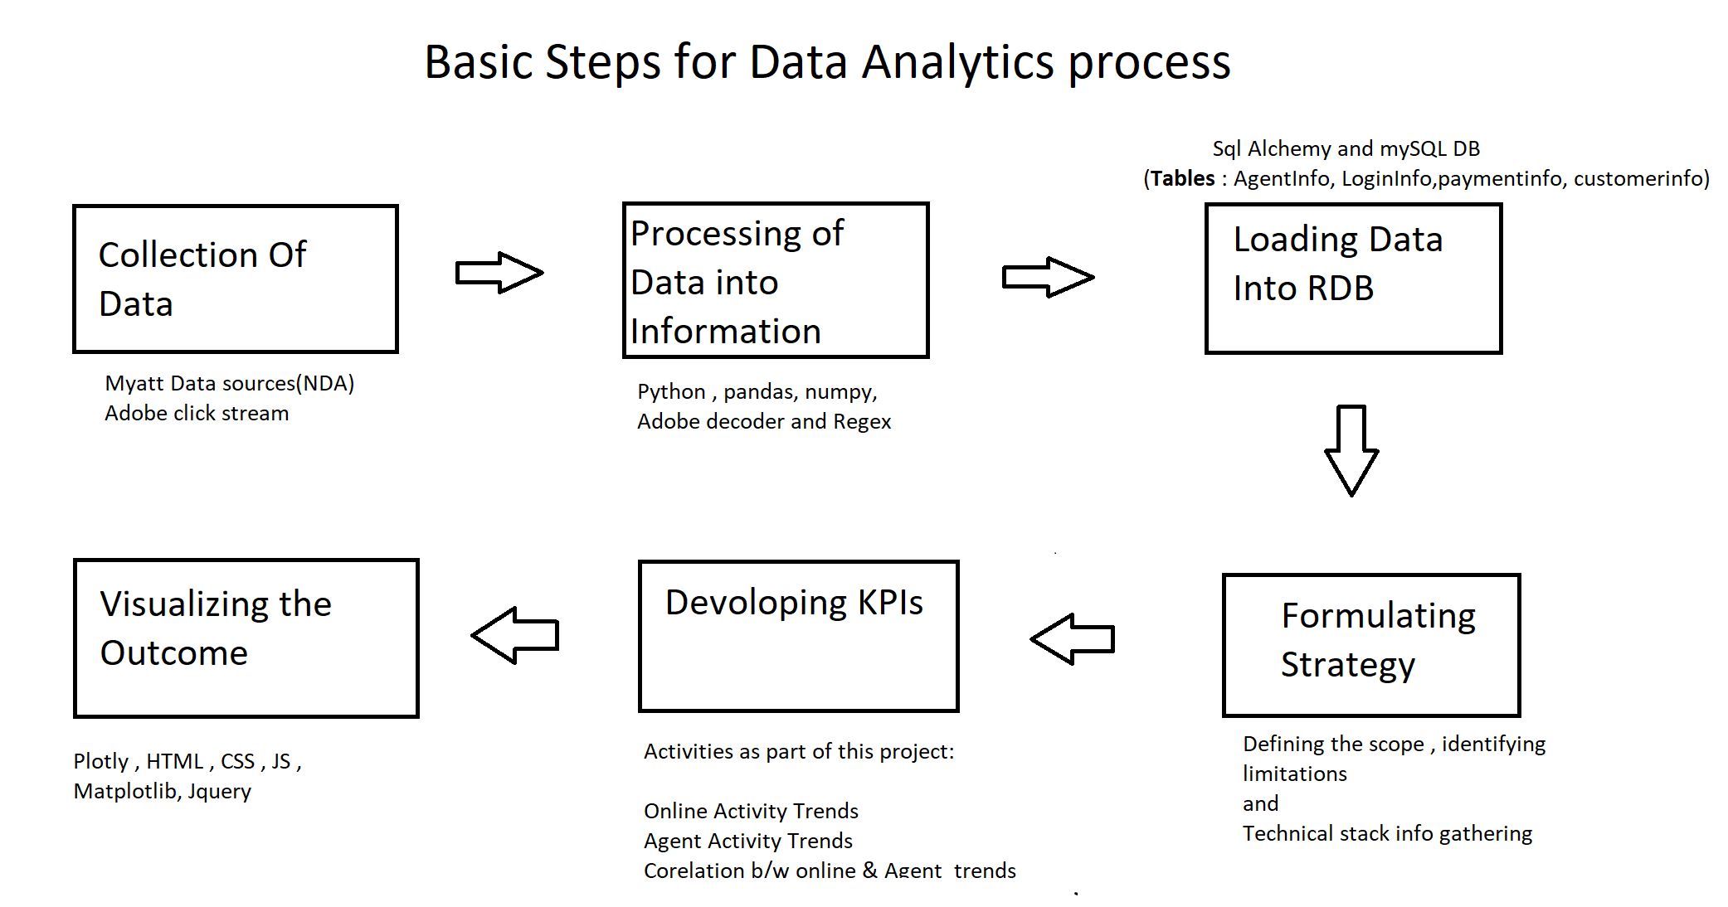
Basic steps of the analytics process
Notes:
Consider talking about:
Web analytics technologies
Web analytics data sources
Web server log file analysis
Page tagging
Logfile analysis vs page tagging
Hybrid methods
Geolocation of visitors
Click analytics
Customer lifecycle analytics
Other methods

Slide 5
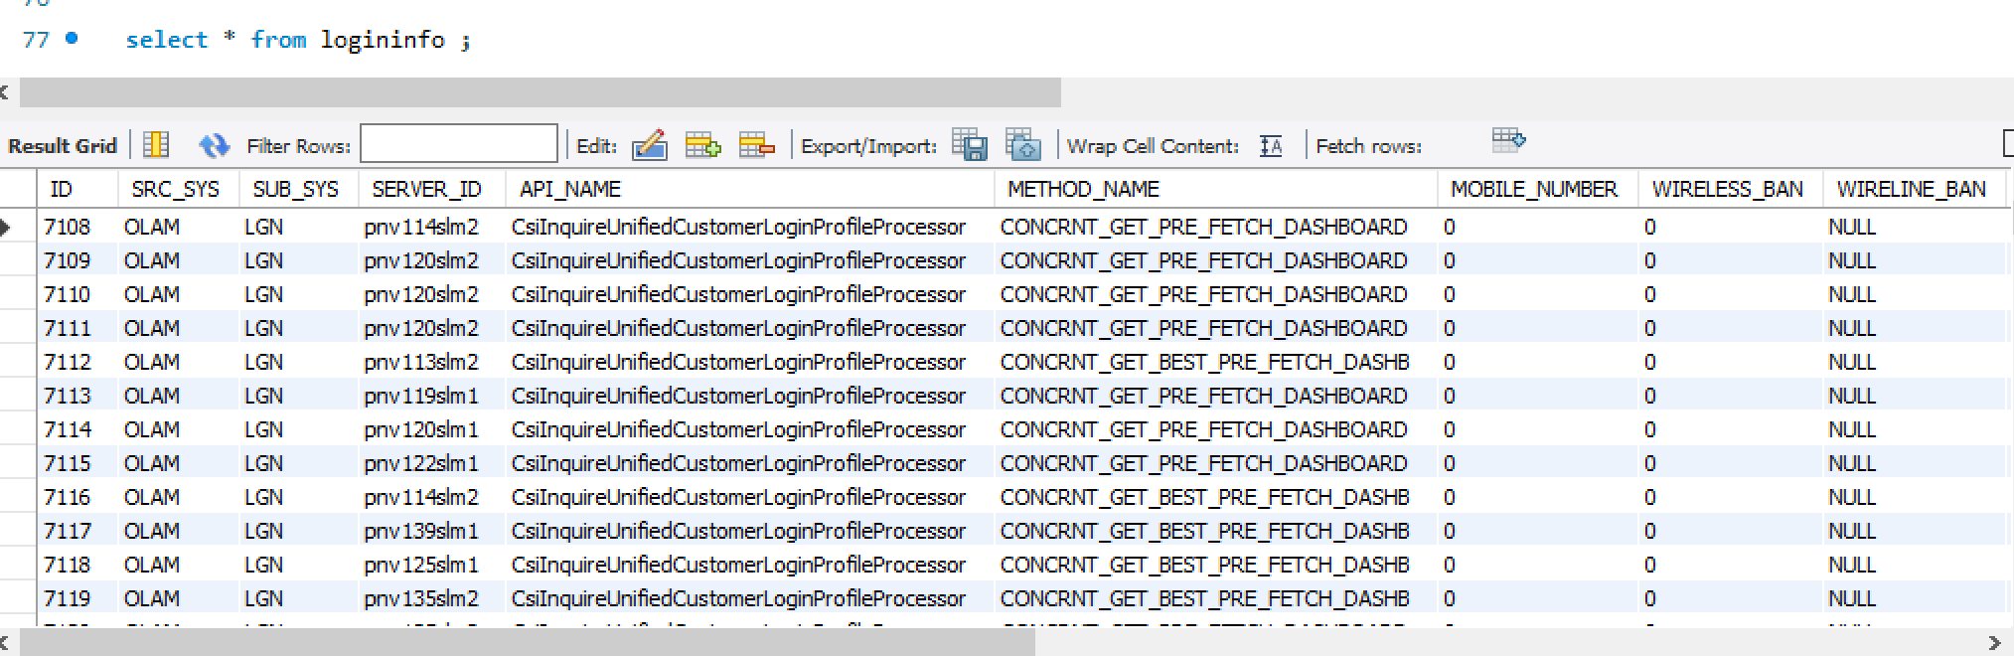
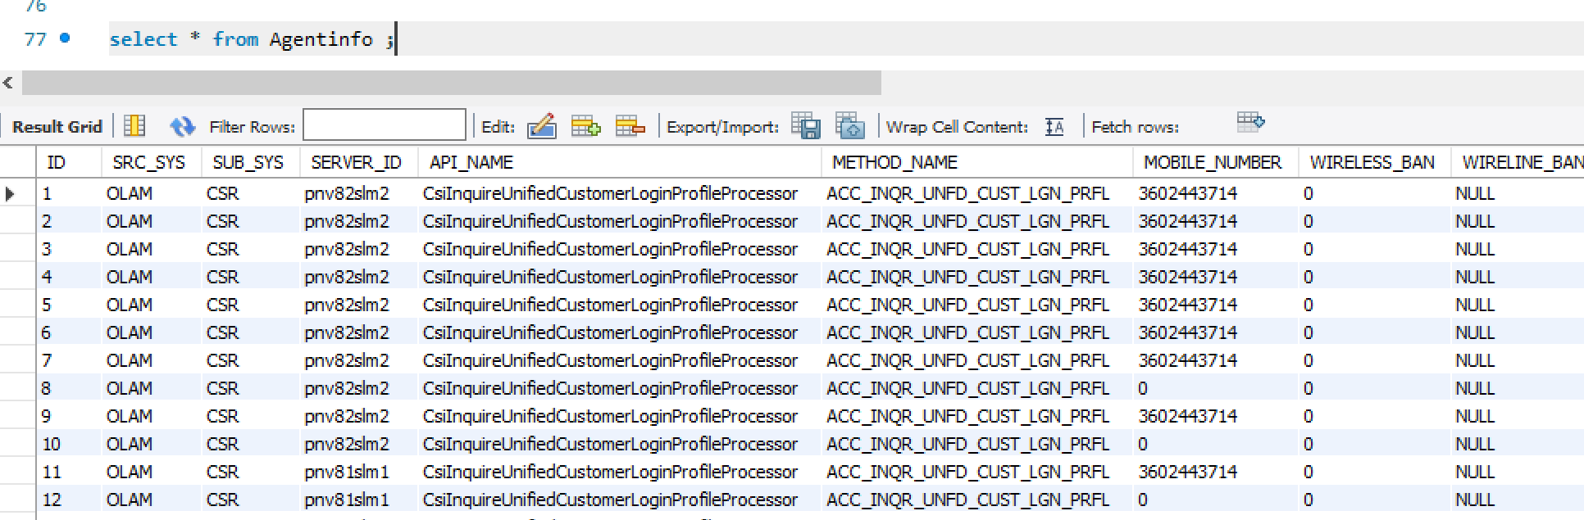
Source Of Data
Data was collected from myATT Prod Data Bases and Adobe stream capturing’s.
Analyzed and cleaned the data using Pandas Data Frame operations.
Using SQLAlchemy Classes Performed ETL operations and stored entire data in local Database.

Slide 6
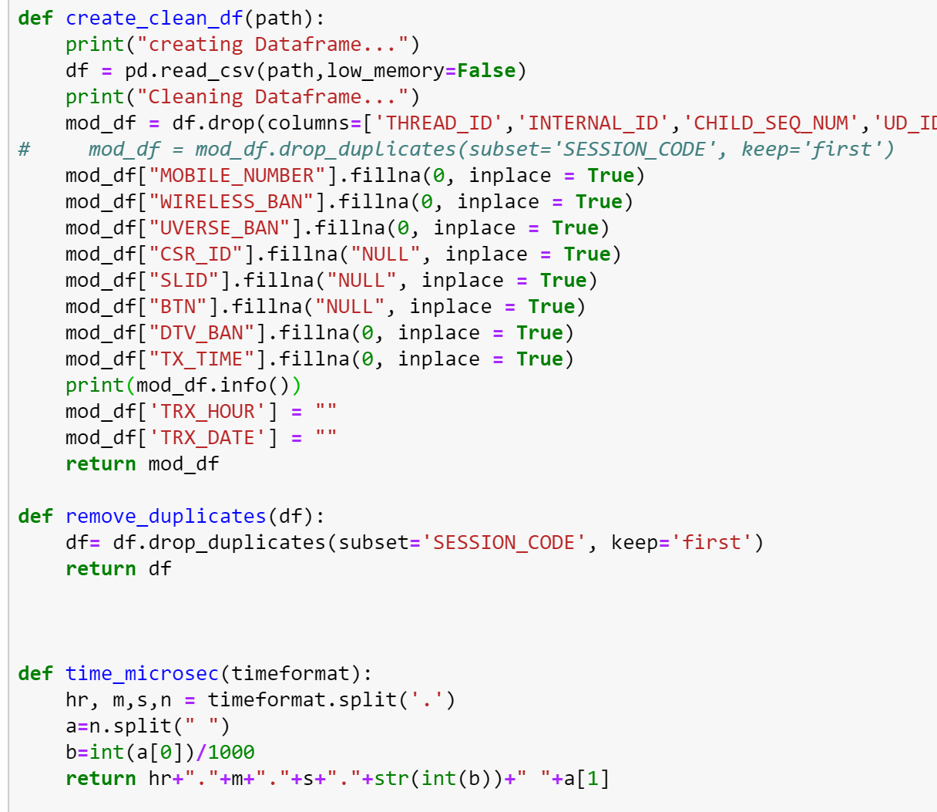
Data Cleaning
Cleaning of Data :
Prod DB data is too huge , so removed the data in accordance with scope of the project.
Ensured the Datatypes accuracy.
Removed NANs and replaced few with “null” string or Zero .
Renamed columns.
Corrected Timestamp format.

Slide 7
Technical Stack
Plan is to tell a story about ATT customer trends and for that i choose easy navigable single website and seem less retrieval of data for pretty visualization.
To achieve above , we used below technical stack :
Retrieval : Python , SQLAlchemy framework
Insertion : python , SQLAlchemy framework
Creation Rest endpoints : Python , SQLAlchemy and Pandas.
Business logic : Python and Java script.
Visualization : Matplotlib, Plotly (express & offline) and D3 Frameworks.
Front end : HTML , CSS, Jquery and JavaScripts.
Database : mySQL
Server : Flask Framework
ML Models : SKLearn & Tensor libraries.

Slide 8
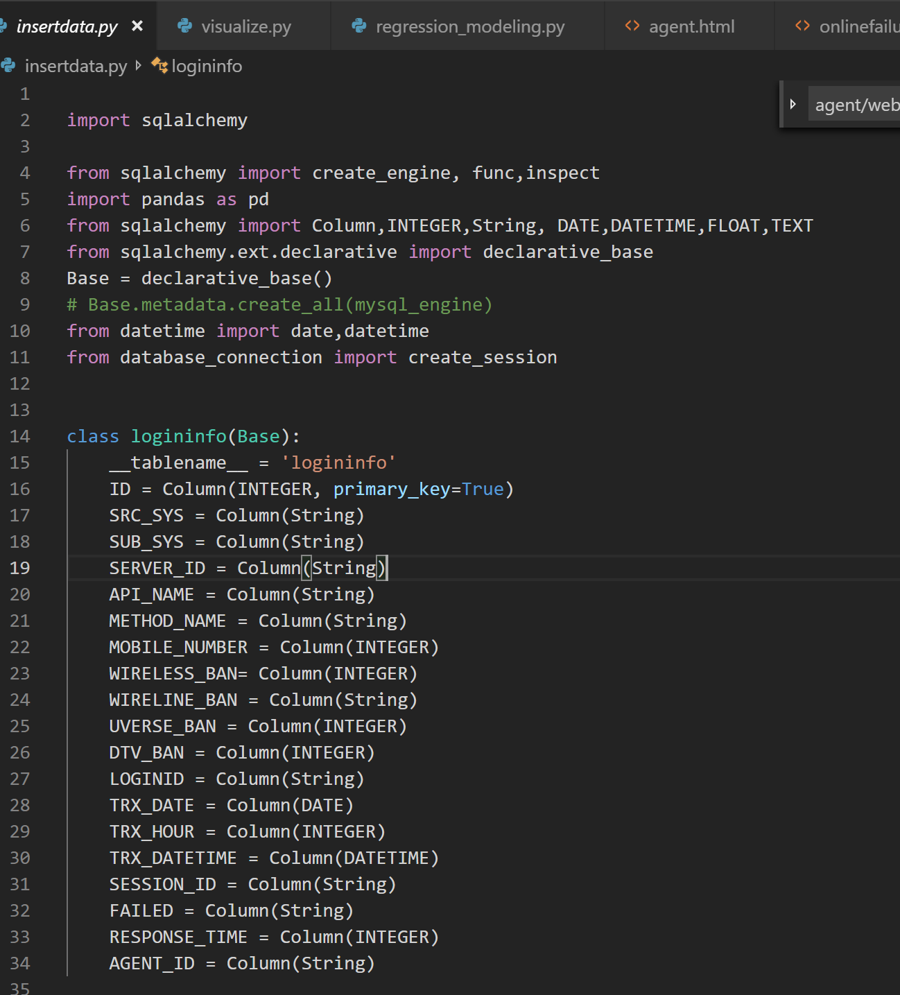
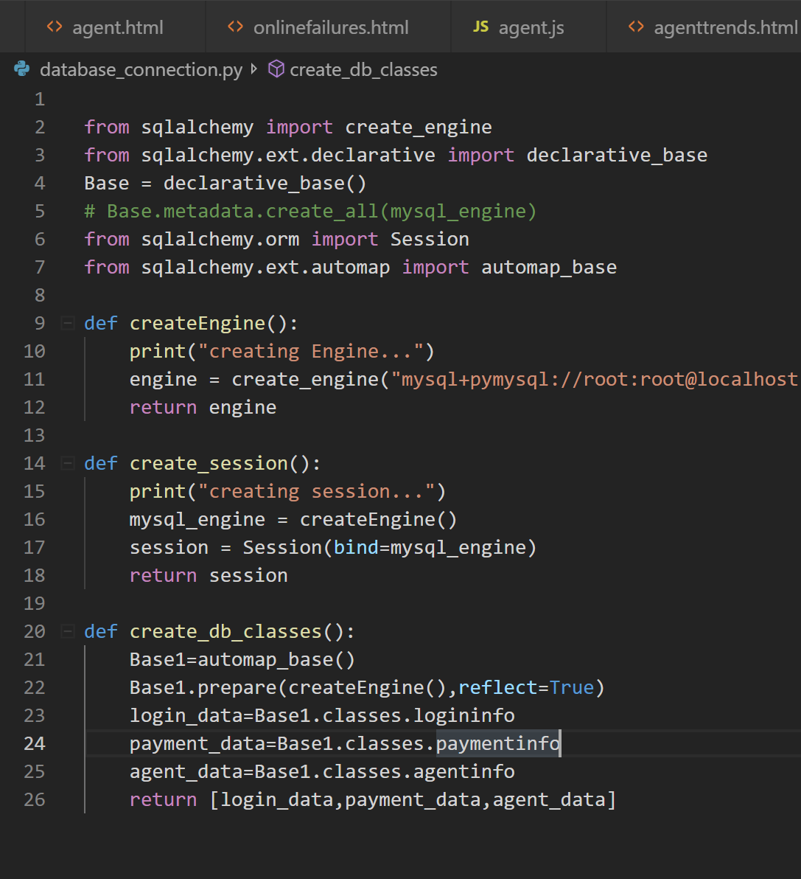
ETL Activities
Created the Database and Tables using mySQL Database.
Created the schema classes using SQLAlchemy and inserted the data to database.
Ensured that schema class datatypes matches with Database.
Insertdata.py contains code for insertion and committing of Data to local database.

Slide 9
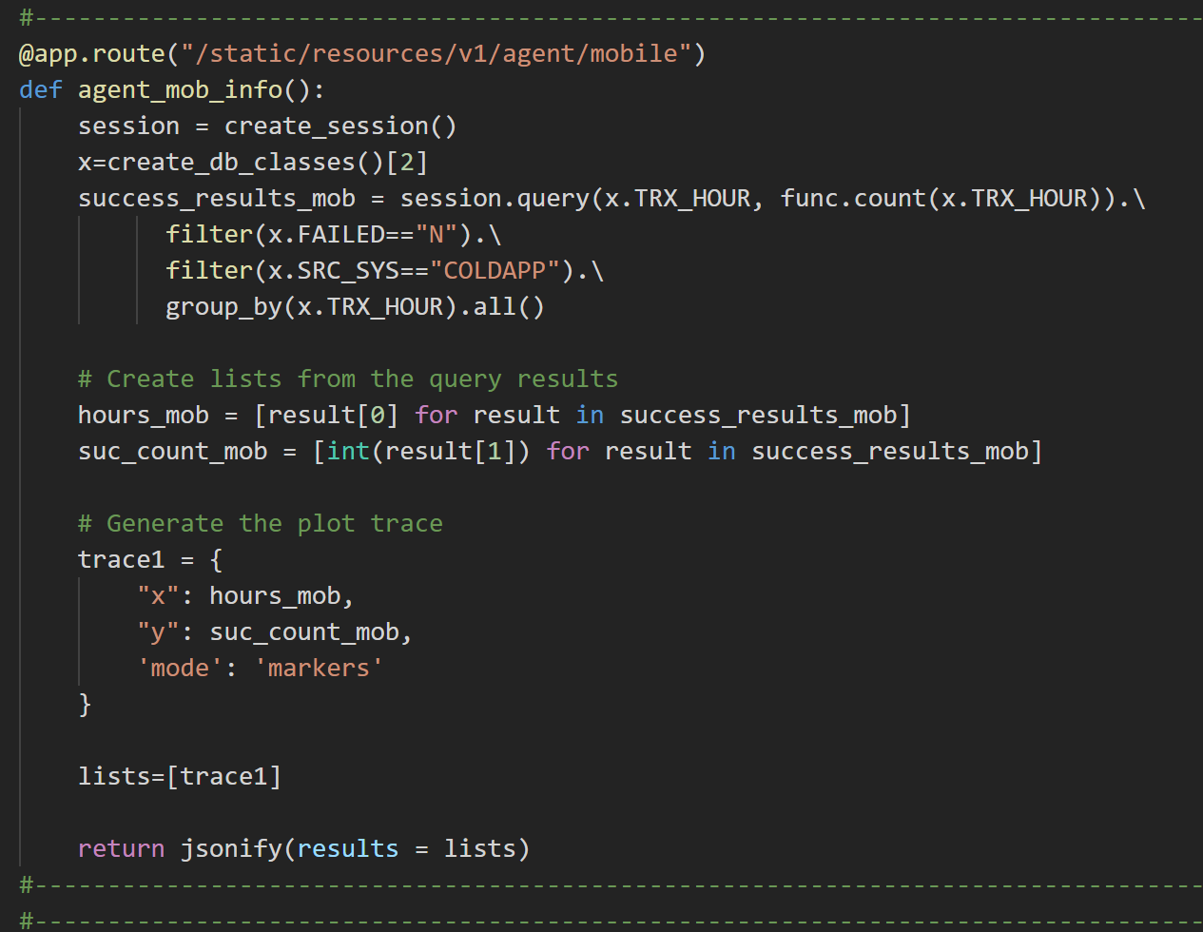
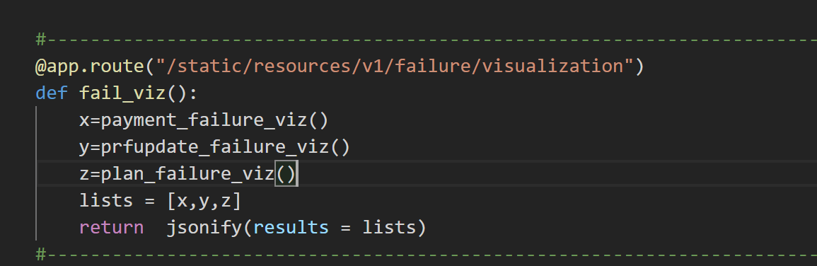
Rest Endpoints
Created Rest endpoints to give the intended data.
All the rest endpoints are formatted with standard context: /static/resources/v1/<functionality>/<subfunctionality>
Rest endpoints are created to retrieve the data or to create local images/html files. (none of displayed image is a hardcoded one).
Here are few rest endpoints :
/static/resources/v1/failure/visualization
/static/resources/v1/agent/mlr
/static/resources/v1/unauthpayment/mlr
/static/resources/v1/data/failure
/static/resources/v1/agent/web
/static/resources/v1/agent/mobile
/static/resources/v1/agent/searchinfo
/static/resources/v1/paymentinfo
/v1/logininfo/mobile
/v1/logininfo
/static/resources/v1/paymentinfo/mobile
/static/resources/v1/paymentinfo/web
/v1/loginandpayment

Slide 10
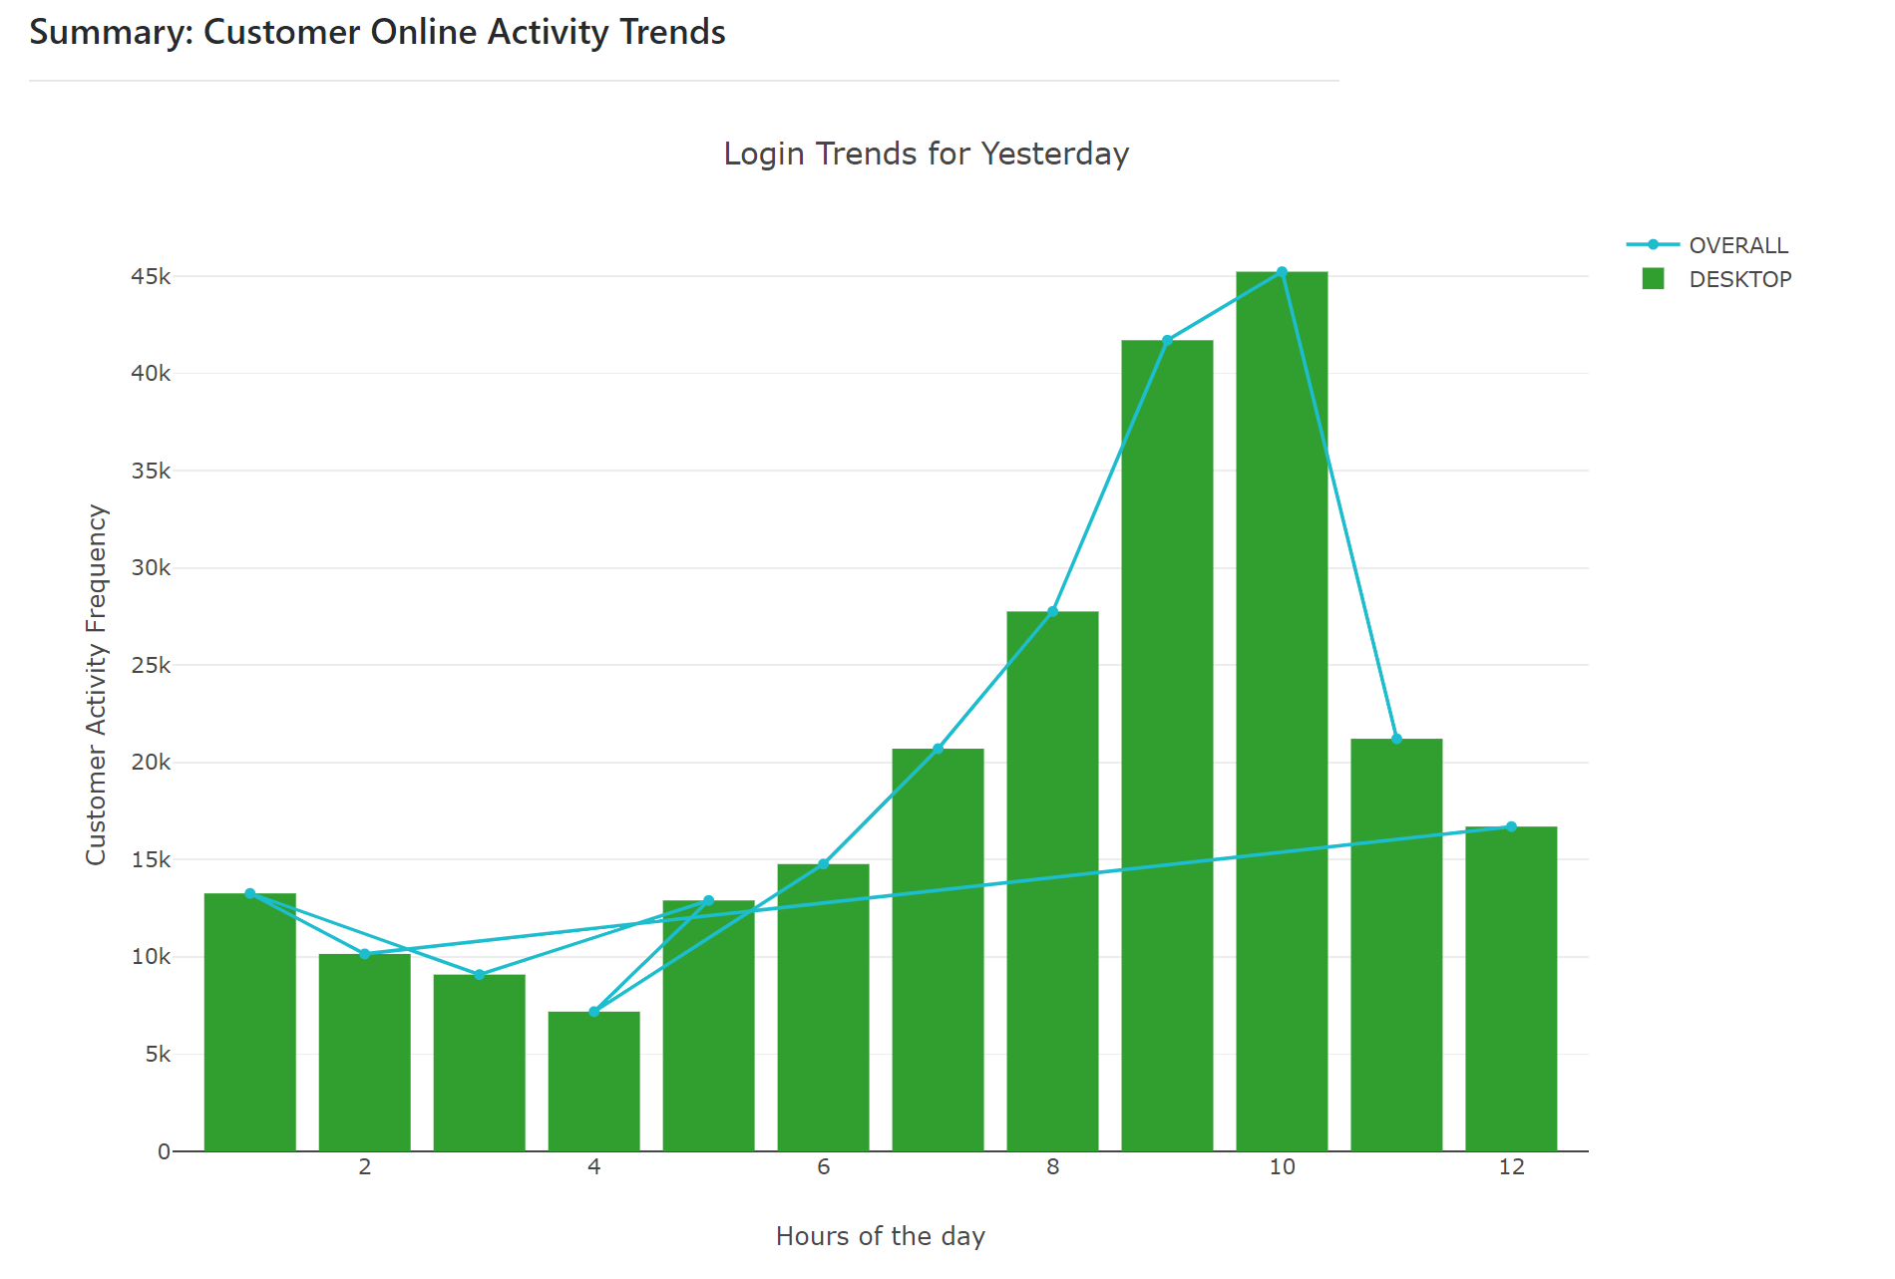
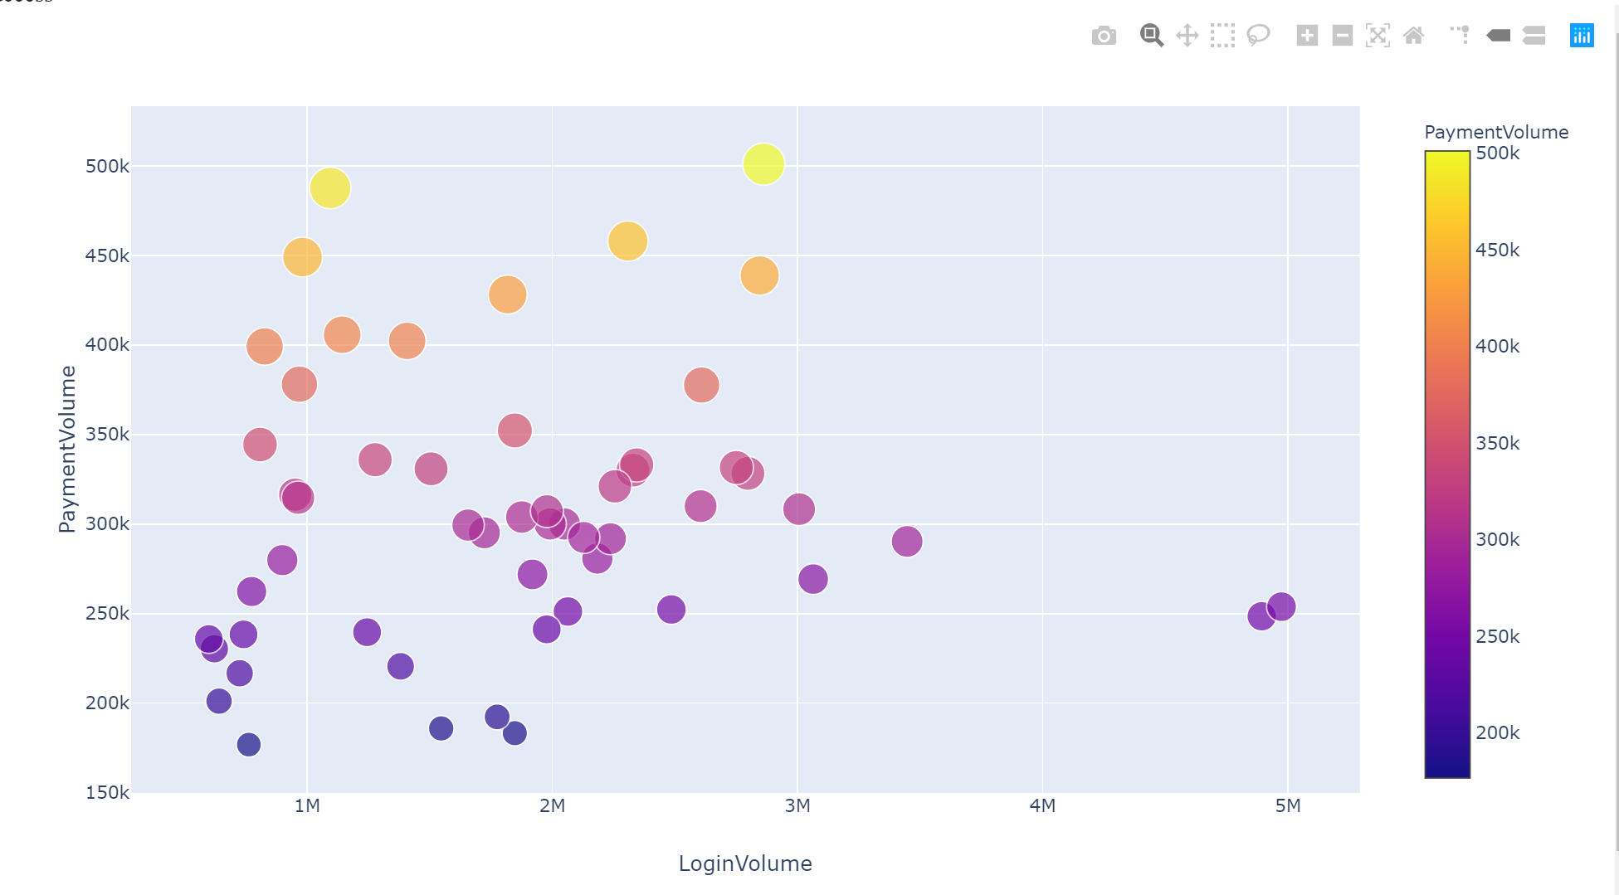
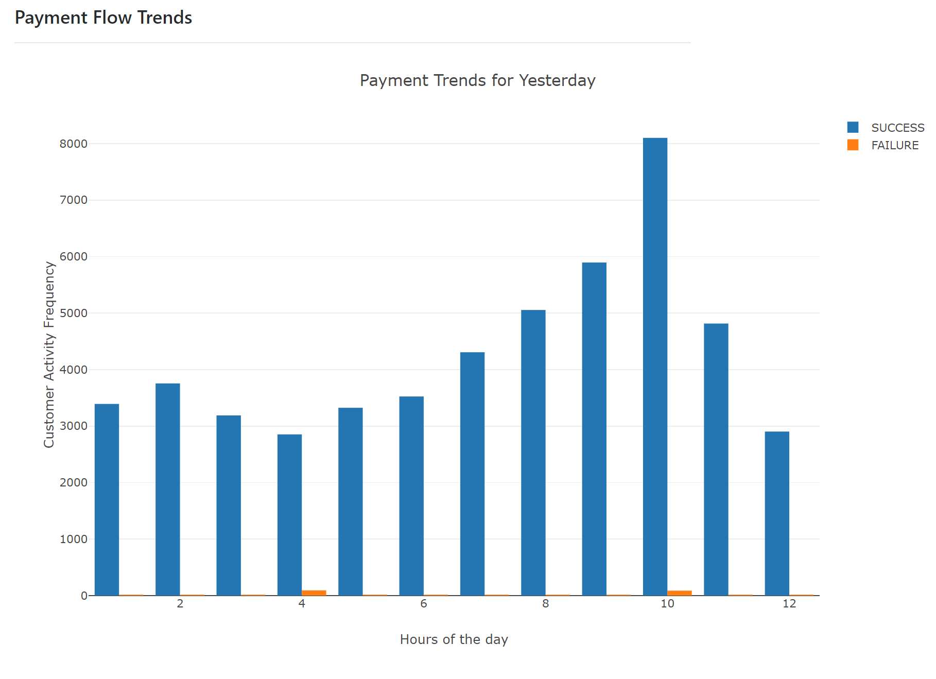
Visualizations
Visualizations are key for story telling.
To have a good story, need to present it better with enough background before going to play with the data.
Used plotly and Matplotlib for Visualization.
Visualization are provided for :
→Current Login Trend (Mob vs Web)
→Agent Activity Frequency
→Payment Trends
→Online Failure vs Successful logins

Slide 11
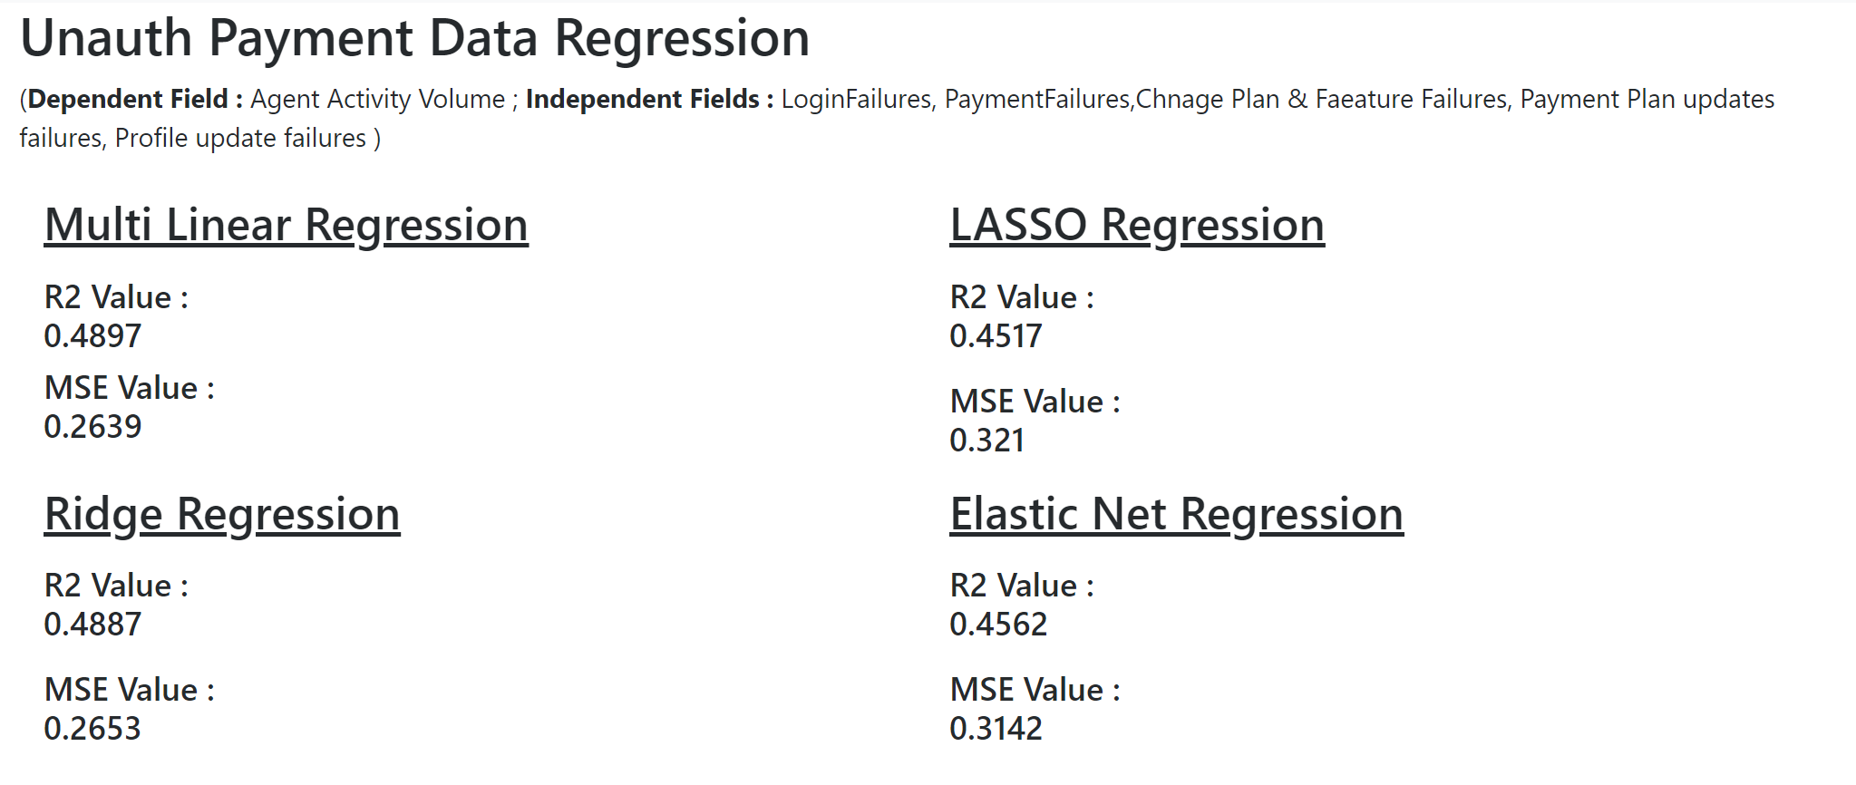
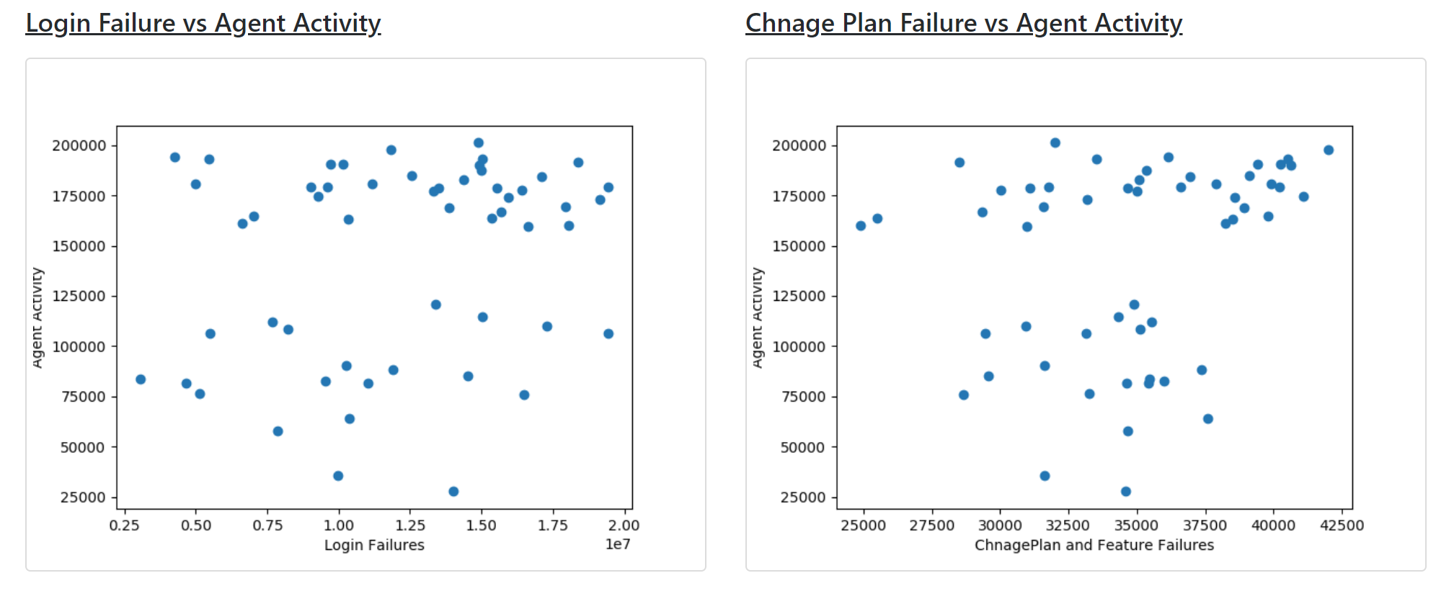
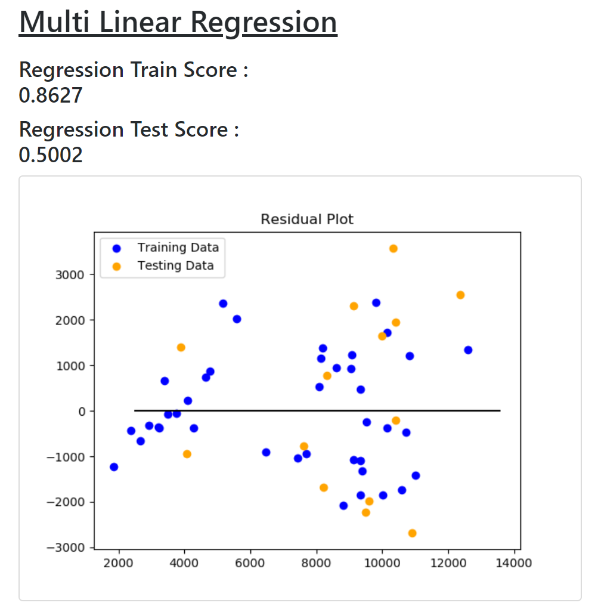
ML Models:
Used ML for tracking relationship between :
Online failures impact on Agent activity frequency ?
Online Login/Payment Failures driving customers to unauth payment flow ?
More online login meaning more revenue ?
For above hypothesis we used :
Multi Linear Regression.
LASSO Regression Model
Ridge Regression Model
Random Forest Model.
Applied Scaling & Normalization as Login volumes are usually too high when compared to other entities.

Slide 12
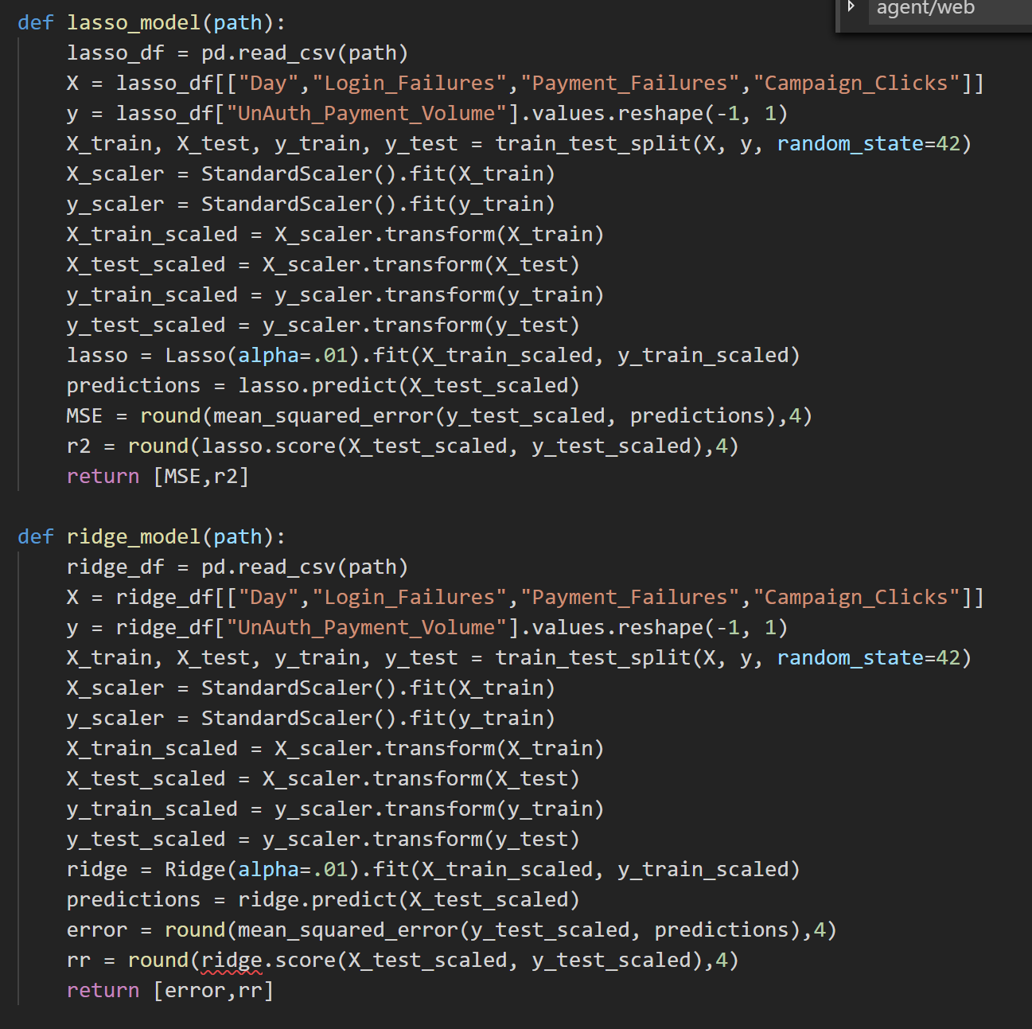
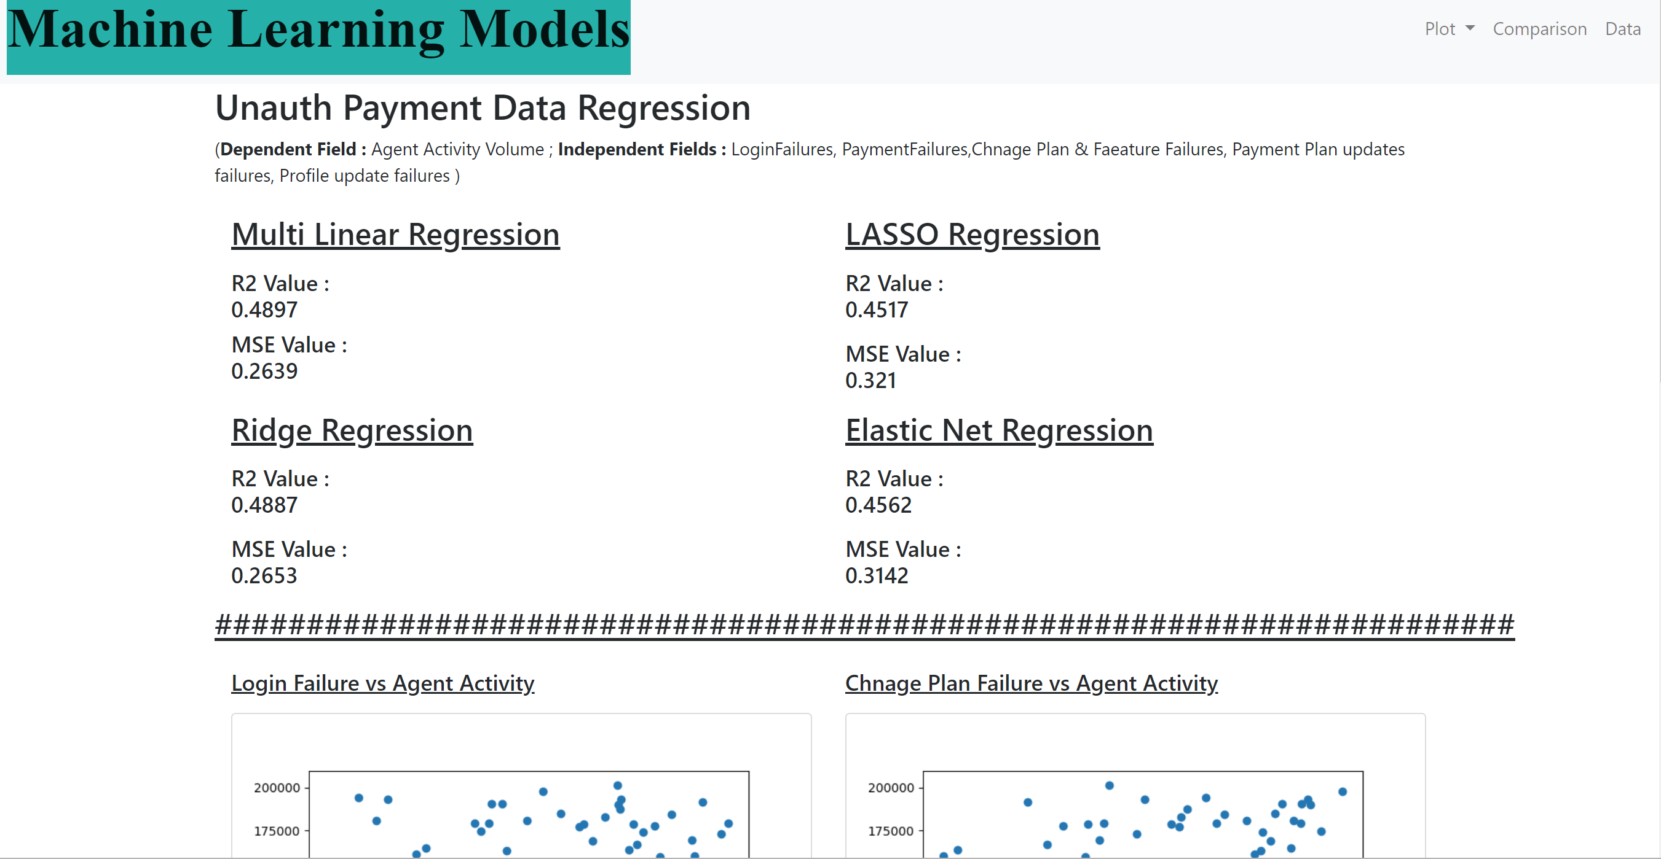
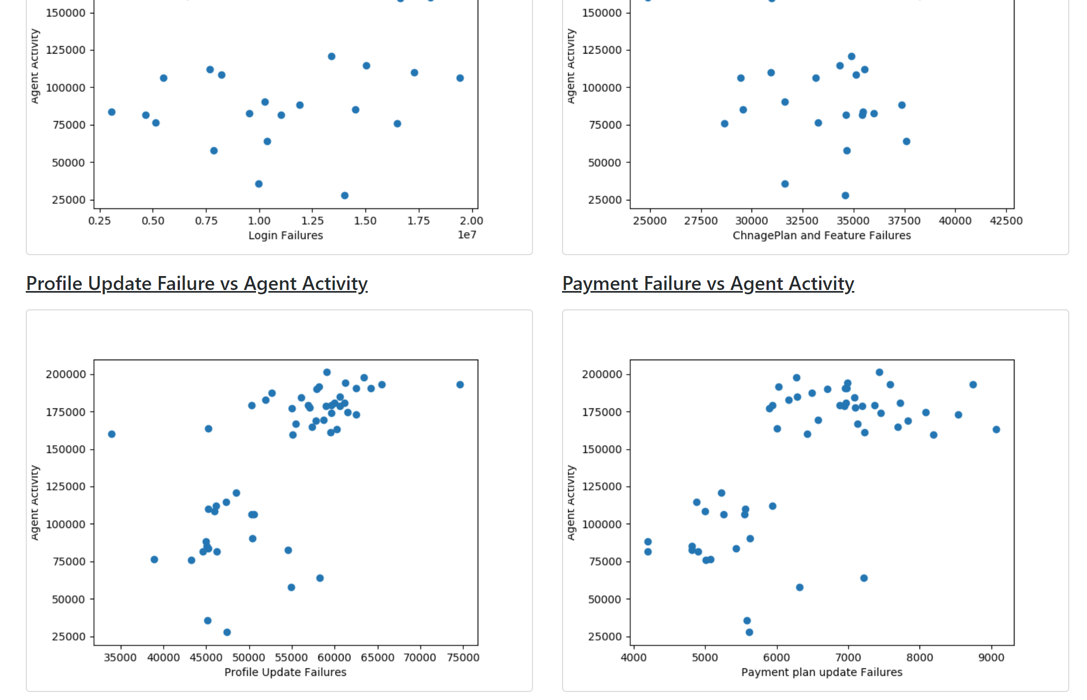

Slide 13
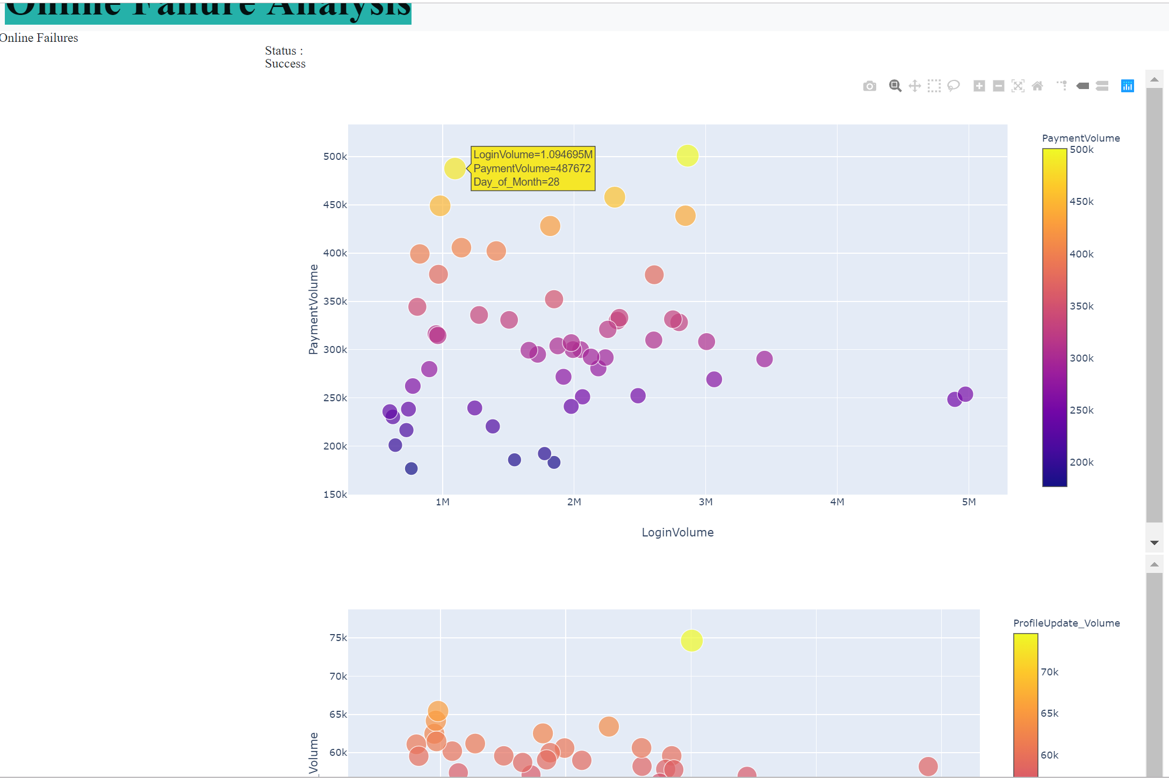
Frontend
Front end everything is within HTML using CSS & JS.
And the pages are rendered on server using Flask framework.
On HTML page load/click → Javascript/jQuery will be invoked → which makes a rest endpoint call to Python → JS will format the returned data → Renders the visualization on HTML canvas using plotly.
Few of the HTML pages render another HTML page using iFrames and those HTML pages are created on workspace location using Plotly Offline framework.

Slide 14
Conclusion
There is hardly relation between online login failures to agent handling volumes. Our data suggests that there is no strong linear correlation as Linear correlation coefficient is too small(~0.3)
But Change plan or Feature failures had a strong linear relation indicating that they reach to agents.
Our data indicated that login failures or post login payment failures doesn’t have any relation with driving traffic to Unauth Payment flow. Our model had r2 value as ~33.8 indicating low accuracy.
Also increasing in login volumes will not increase any failures instead brings revenue.

Slide 15
Limitations
Can’t able to use more ML models due to data limitations.
Data is not real time , flowing in a day delay.
Unable to make application on Heroku.
Descoped the plan on run time due to time & data constraints.
Data insertion is a manual trigger.
Didn’t implemented multi threading instead used async calls with a hardcoded delay(specifically when a JS is making call to multi python endpoints).

Slide 16
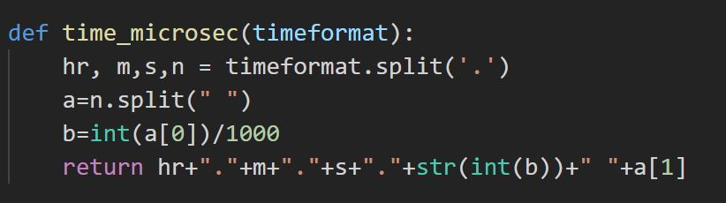
Challenges
Data time conversions - Python Datetime library doesn't have doesn’t have milli seconds support. Took real time to comeup with dirty code.
Amid revoke of prod database access.
Rendering of iframe HTML pages within HTML page. For very first time it works , but on page refresh, HTML path will provide “net::ERR_CONTENT_LENGTH_MISMATCH” error due to heavy cache amount on sever. Mitigated with a patch work , by explicitly clearing cache on each load on each iframe.
Making D3 Js smart enough to understand how many traces returned by python endpoint to render graph.
Race condition when JS is trying to two python rest endpoints async. Server is turning down one.

Slide 17

Any Questions… ???
Special Thanks to :
Bill Alexander.
He ideated this with a new thought process called “Data Driven Architecture”.
Notes:
Consider talking about:
The hotel problem

